Slide 1

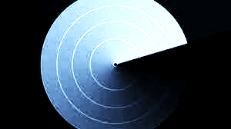
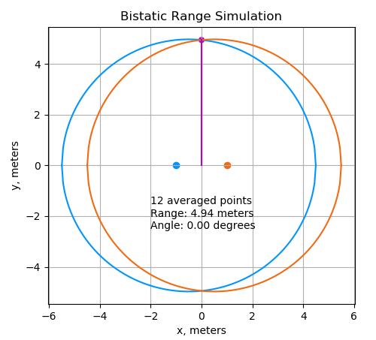
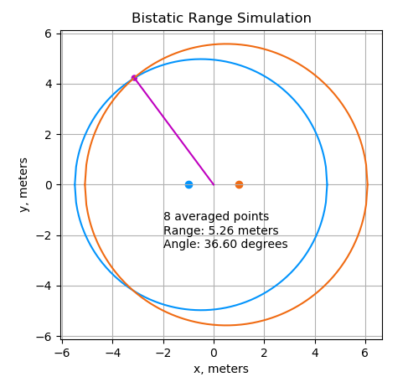
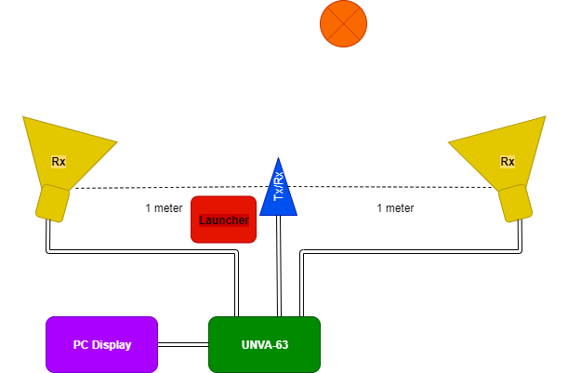
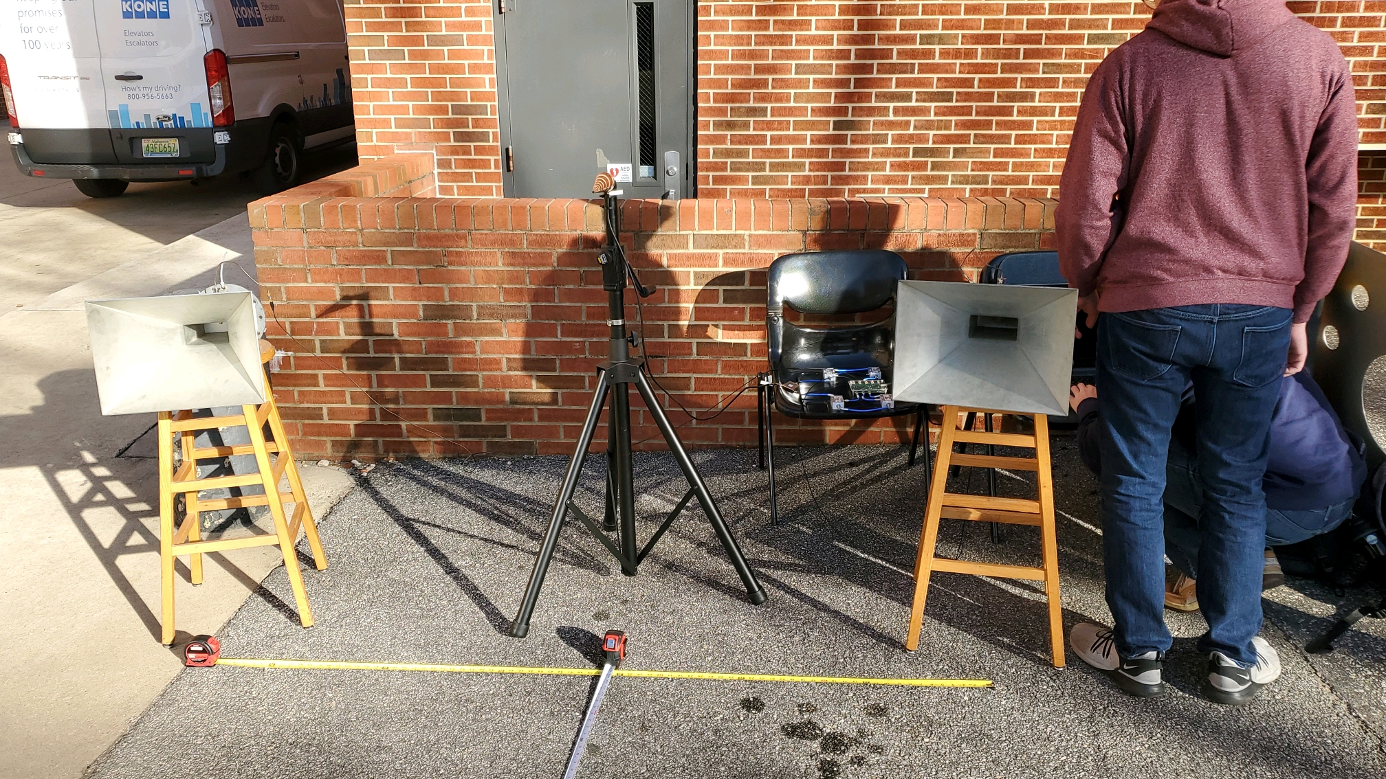
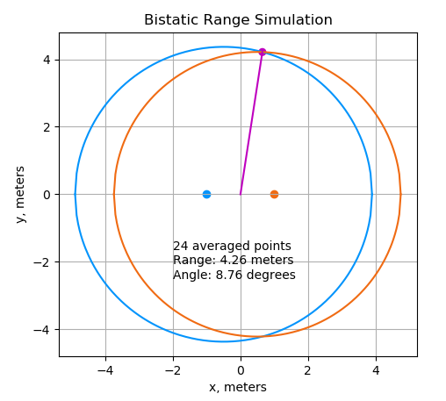
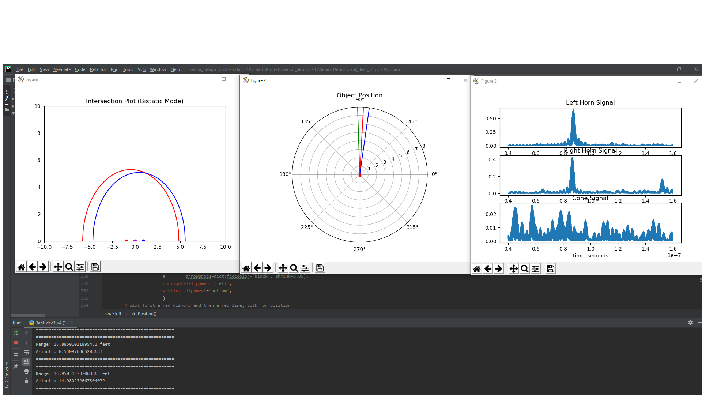
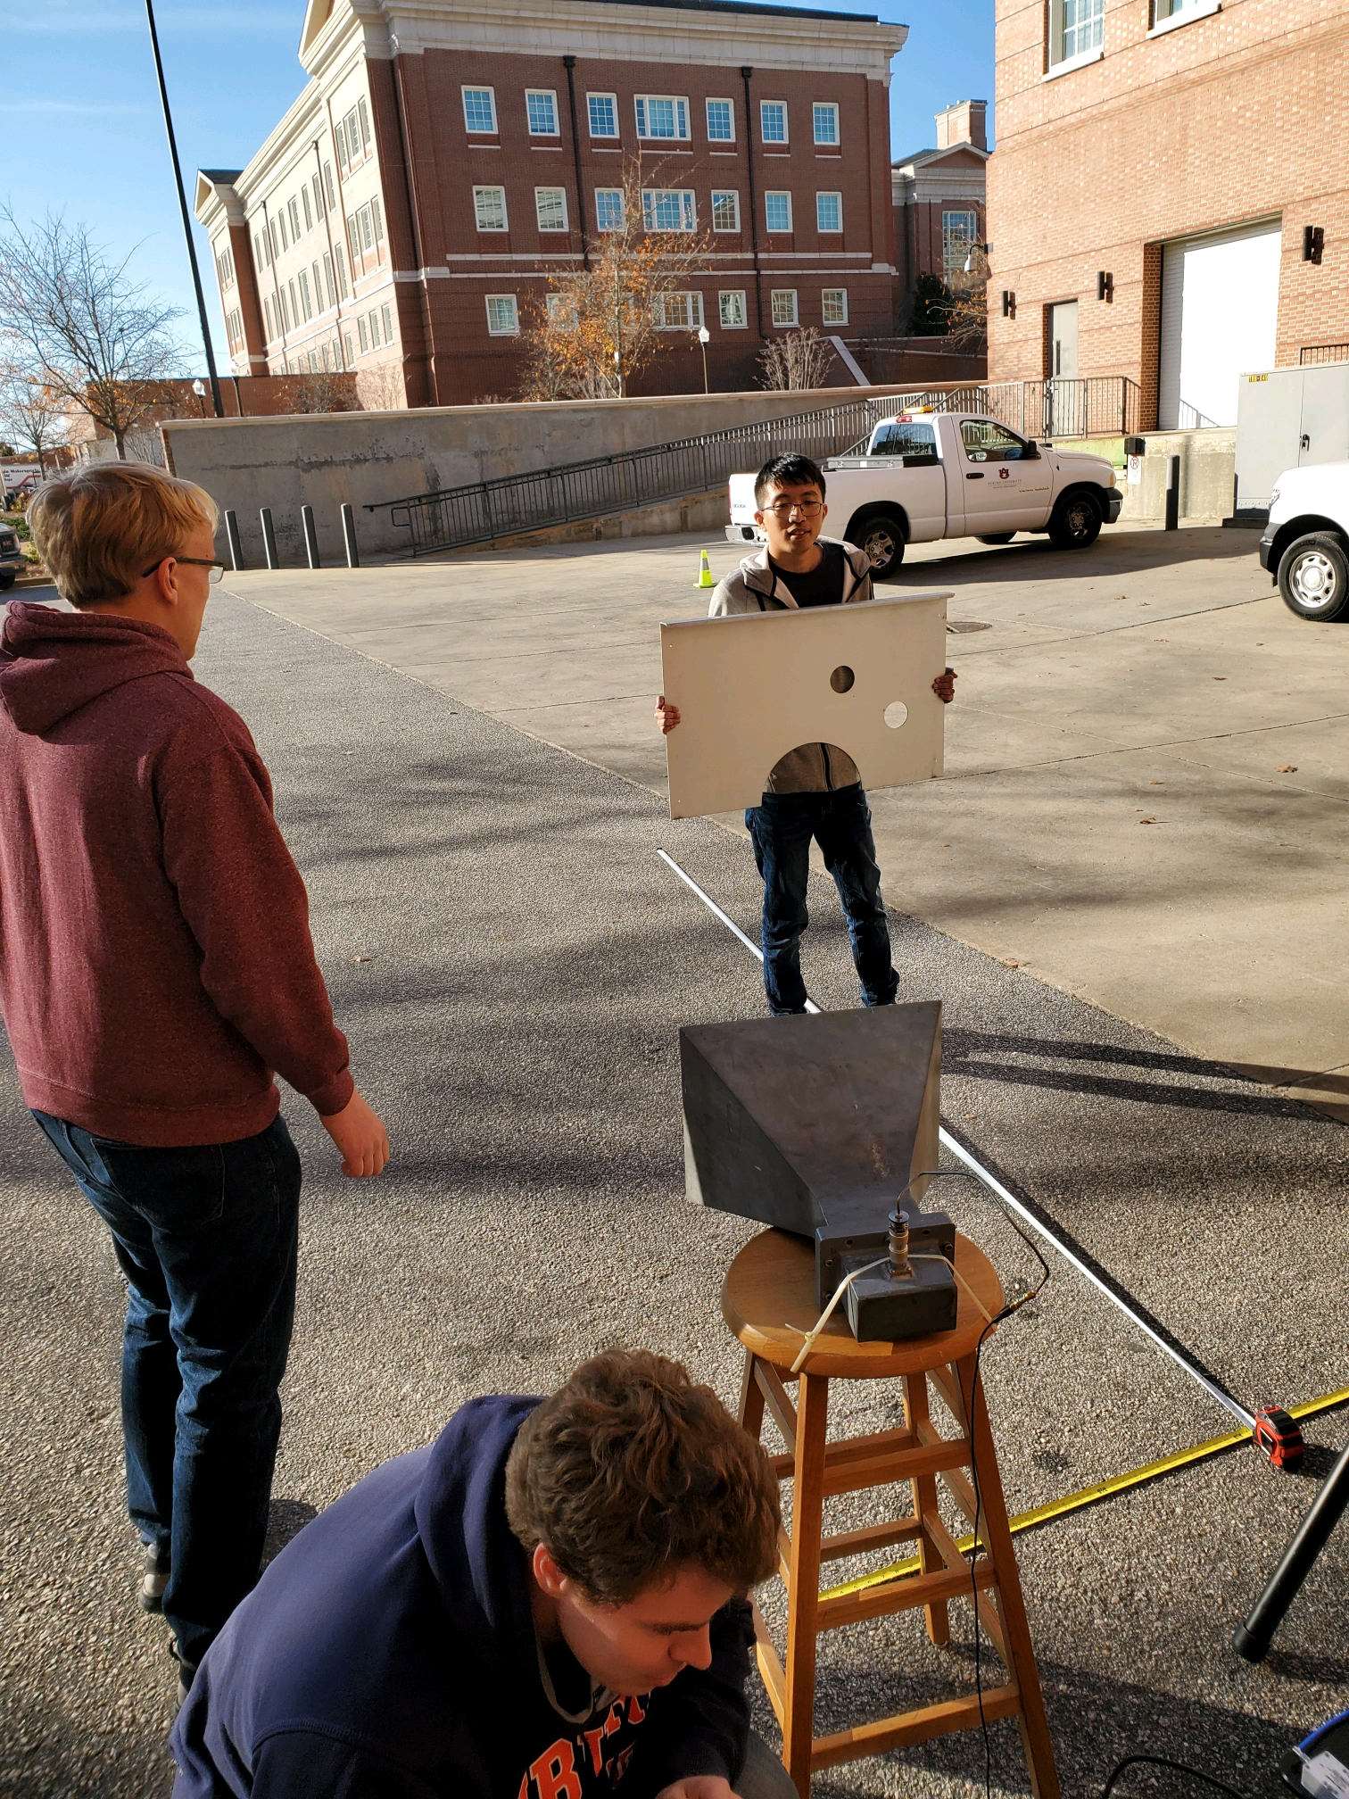
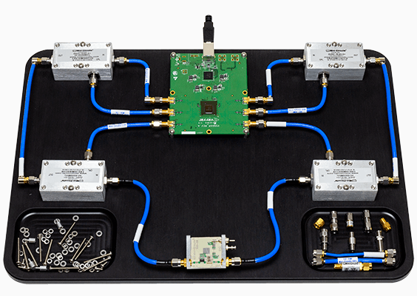
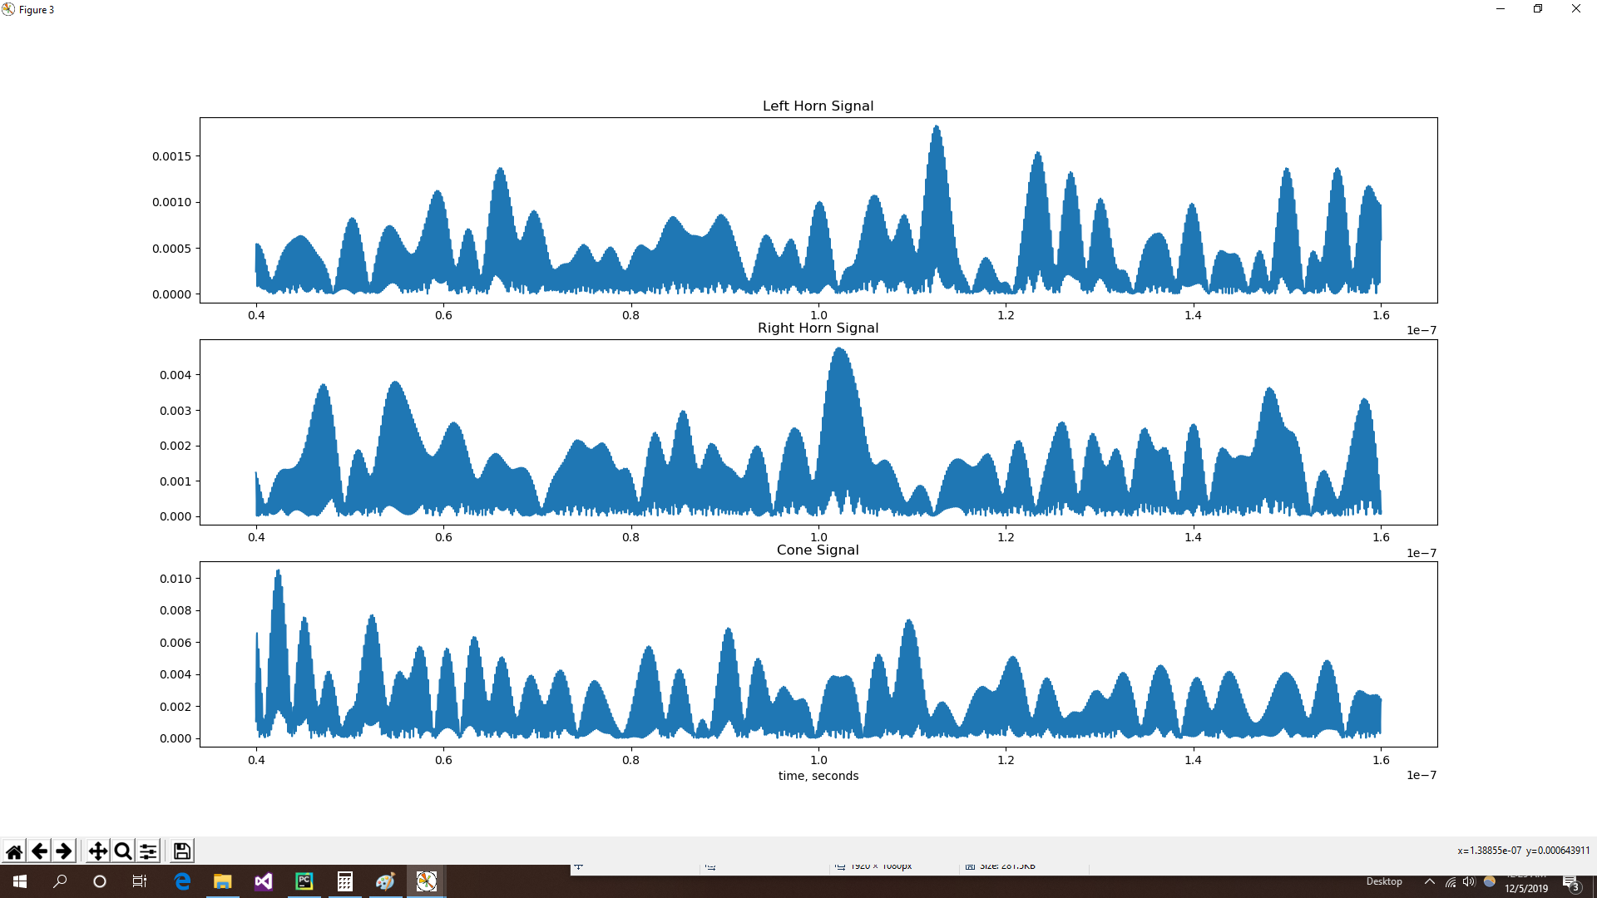
Position Finding Radar
Jarod Vechinski, Graham McClelland, George Yuan, and Travis Keller
Introduction
Building upon previous Radar projects that only implemented range, we wanted to take that further and implement real-time position finding. We utilized the UVNA-63 kit from MiniCircuits to process the signals and calculate the range and angle, and translate it into a visual plot reflecting the target position.
Radar Design
This Radar design consists of two L-band horn antennas and a wide beam cone antenna. The cone transmits 100-equally spaced frequencies from 2500MHz to 3000MHz later received on the two horn antennas. The two horns are placed 1m apart from the center cone antenna. The horn antennas receive the return signal after reflecting from a target.
Simulations
Picture of setup?
Detection Modes
“Cone” Mode
When the return from the dual TX/RX antenna is suitable, it enables direction ranging from the center antenna.
“Bistatic” Mode
For longer ranges at which the center antenna no longer is a reliable source of range information. Considers the two ellipses with a tx/rx pair located at the foci.
Birds-eye view of system
Outdoor setup
Test Scenario
Background scan and removal was performed
Metal target was held level with cone antenna and positioned on boresight
Radar was allowed to settle
Target was moved backward and forward to study range and angle measurements
Test Environment & Results
All testing was performed outside to minimize multipath interference from walls and other large objects in a lab. A large metal plate as a target to used to provide a higher quality reflection signal at longer ranges.
Improvements
More accurately determine propagation delays by accounting for cable travel time
Enable better indoor testing by adjusting parameters
UVNA-63 Specifics
Load Impedance - 50Ω
Freq. Range - 100Hz-6000MHz
Power Supplied - 1mW
Sampling Rate - 160 MS/sec
References
Richards, M. A., Scheer, J. A., & Holm, W. A. (2010). Principles of Modern Radar: Basic Principles. Raleigh, NC: Scitech Publishing.
Stuzman, W. L., & Thiele, G. A. (2012). Antenna Theory and Design. Hoboken, NJ: Wiley-Blackwell.
https://courses.lumenlearning.com/waymakercollegealgebra/chapter/equations-of-ellipses/
https://en.wikipedia.org/wiki/Bistatic_range
https://www.minicircuits.com/pdfs/UVNA-63.pdf
Testing with Metal Target

